Slide 1
Actionscript 3.0 Basics
7 – Gaming Apis

Slide 2
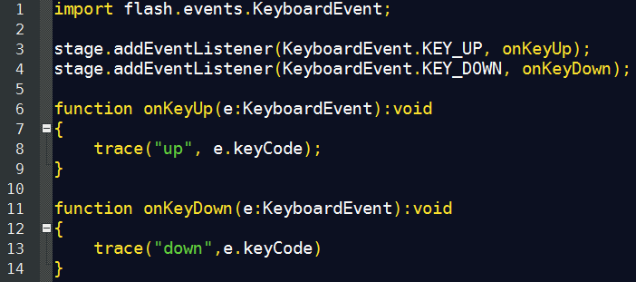
Keyboard Management
KeyboadEvent
KEY_UP
KEY_DOWN

Slide 3
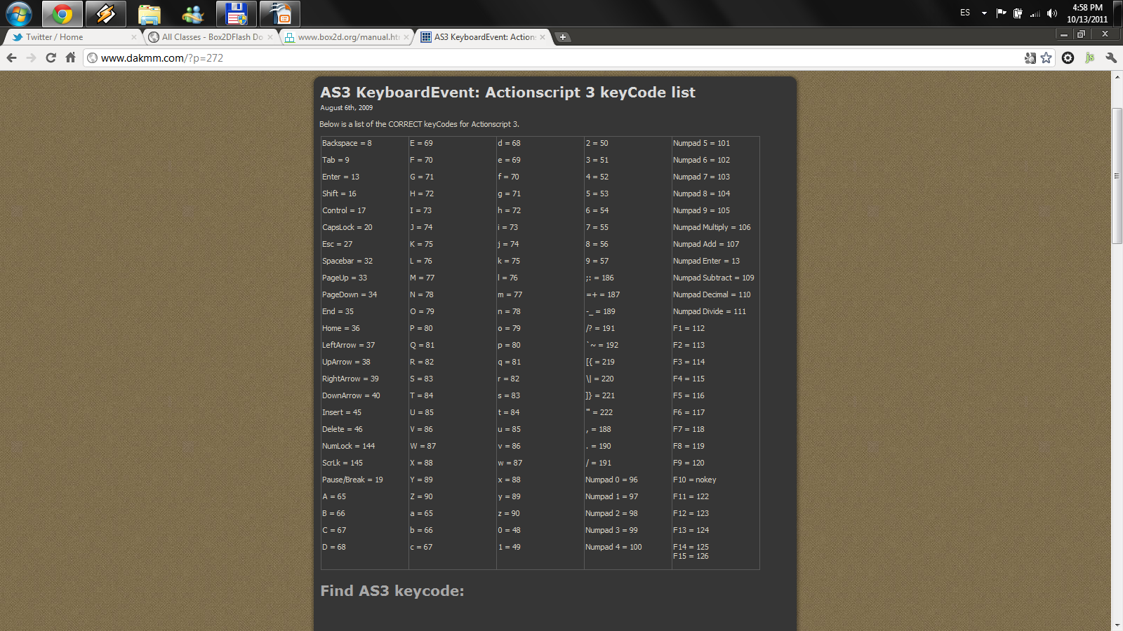
Keyboard Management
You can find many
keycode constants
on the Keyboard Class

Slide 4
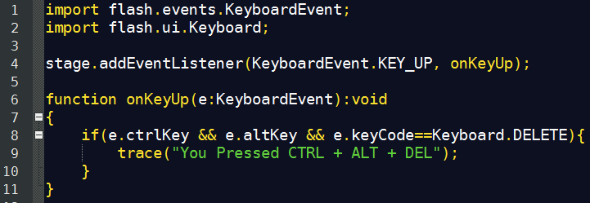
Keyboard Management
You can detect key chain combinations:

Slide 5

Physics Engine: Box2Dflash
Box2D is a 2D rigid body simulation library for games.
From the game engine's point of view a physics engine is just a system for procedural animation.
http://www.box2d.org/
http://www.box2dflash.org/

Slide 6
Box2Dflash
Pros:
Very accurate, realistic simulations.
Continuous Collision Detection (CCD)
Wide community, good support.
Good performance overall.
Cons:
Painful APIs.
Many concepts inherited from C++ version, useless in as3.
Complex code even for simple behaviors.
Requires good physics knowledge (not sugar coded).

Slide 7
Box2Dflash: Main Concepts
World
gravity
Body
mass
position
angle
speed
angular speed
Fixture
shape
density
friction
restitution
Shape
geometrical
properties
Joint
connects bodies

Slide 8
Thanks!
github.com/matix/as3basics
matias.figueroa@globant.com
@matixfigueroa

